Slide 1
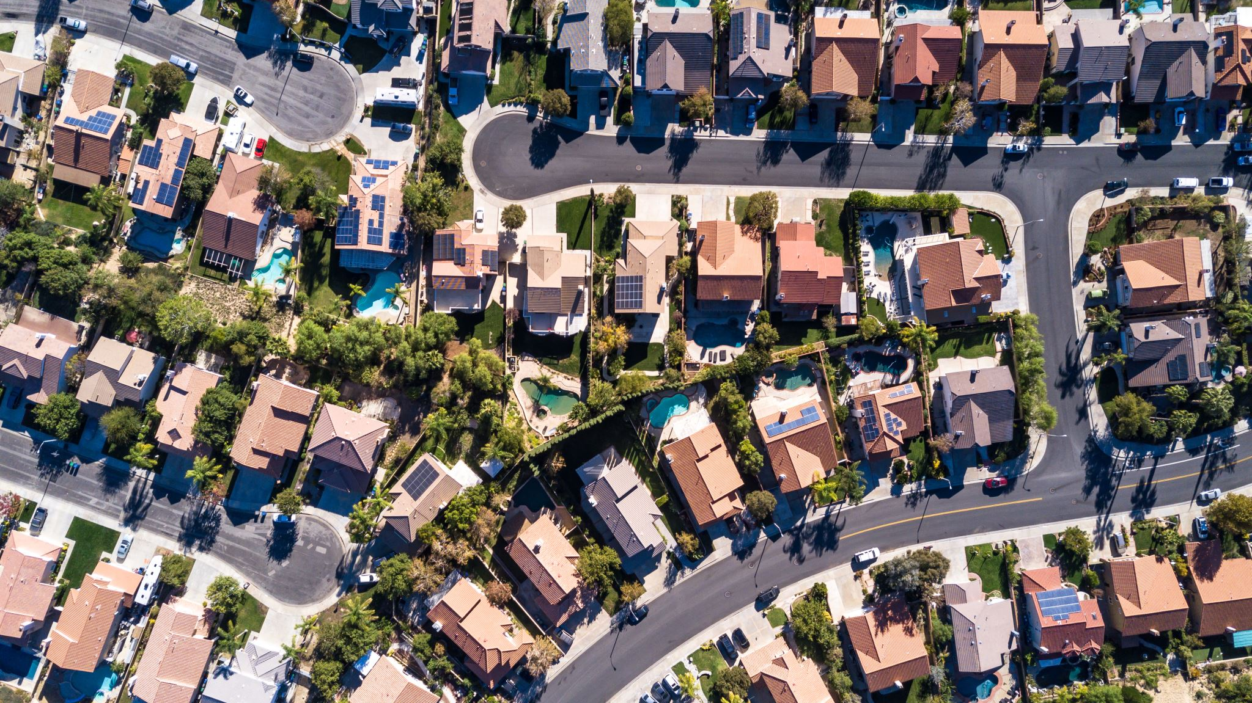
Final Project: California Housing Prices
By Lucia Garrigues and Ekaterine Jorjoliani

Slide 2
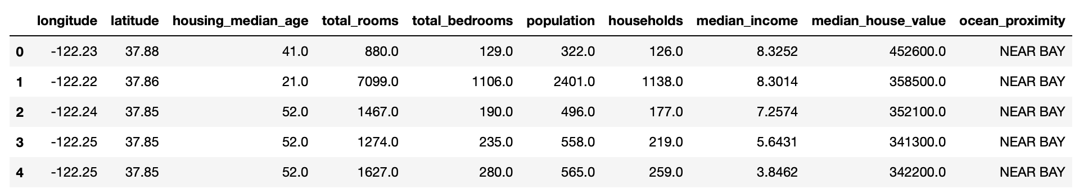
Dataset
https://www.kaggle.com/datasets/camnugent/california-housing-prices
The dataset is about housing prices in California
Includes 10 columns and 20640 entries
Preview of the dataset:

Slide 3

Literature
Initially featured:
Pace, R. Kelley, and Ronald Barry. "Sparse spatial autoregressions." Statistics & Probability Letters 33.3 (1997)
Deprived from:
Hands-On Machine learning with Scikit-Learn and TensorFlow
by Aurélien Géron
Pdf Link: https://powerunit-ju.com/wp-content/uploads/2021/04/Aurelien-Geron-Hands-On-Machine-Learning-with-Scikit-Learn-Keras-and-Tensorflow_-Concepts-Tools-and-Techniques-to-Build-Intelligent-Systems-OReilly-Media-2019.pdf

Slide 4
Objectives
Explore Spatial Patterns and trends
Investigate housing characteristics by the relation of median age, rooms, and bedrooms with median house value
Explore the correlation between each variable and the median house price
Build a prediction model

Slide 5
Data Preparation
Data Loading
01
Finding data types (all numerical and 1 categorical)
02
Handling missing values
03
Finding and handling duplicates if any
04

Slide 6
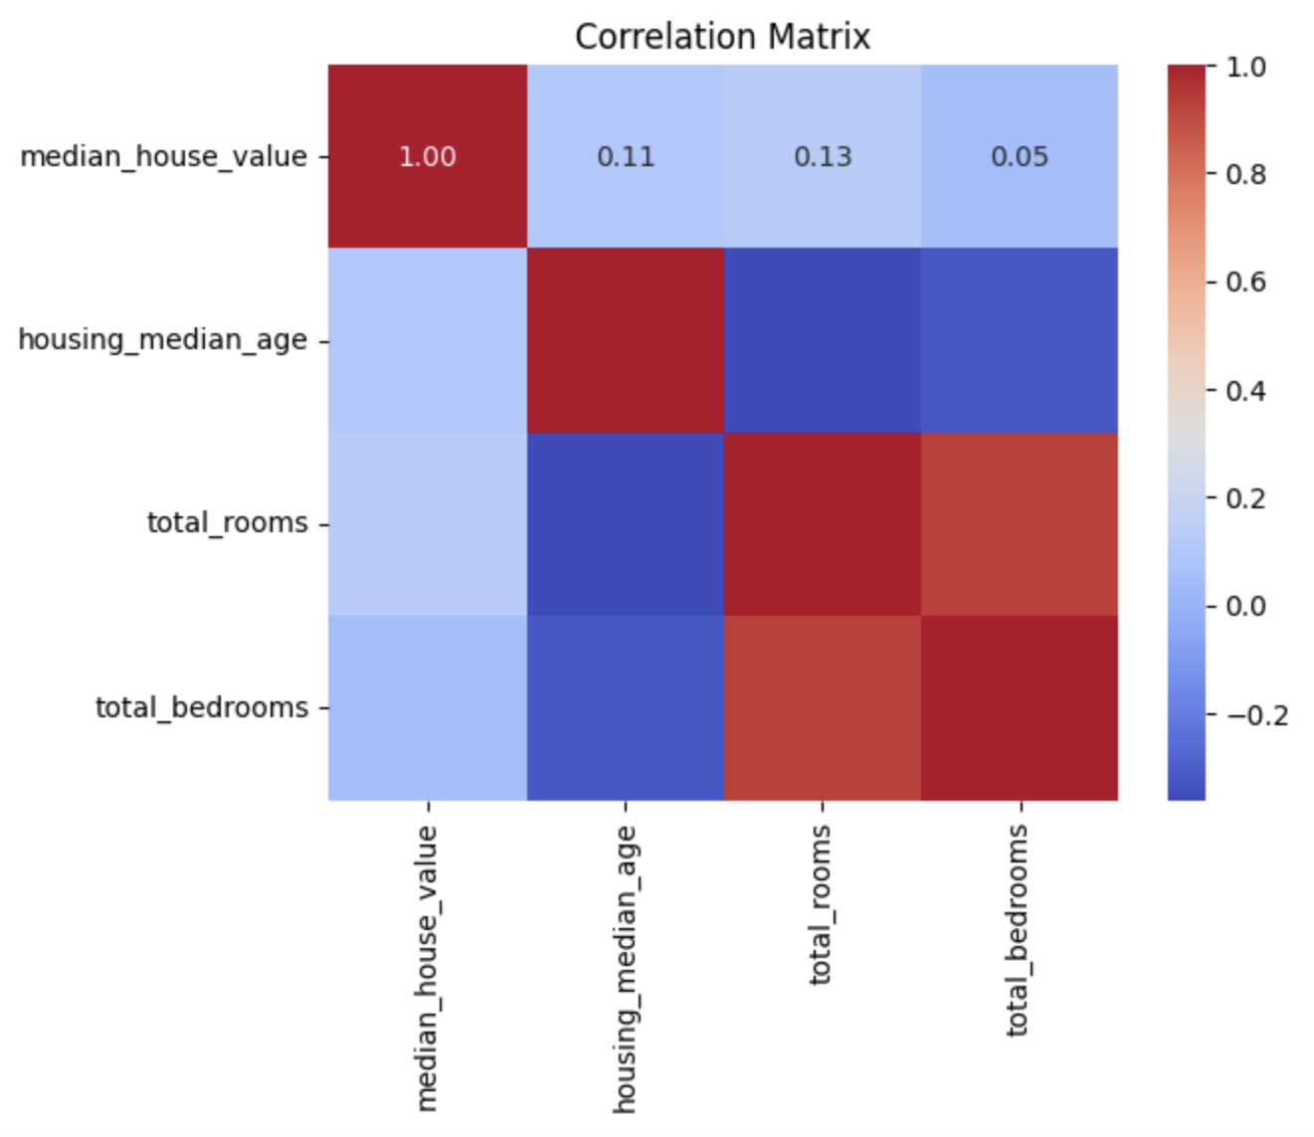
Visualizations
See the correlation between variables
Darker color – higher correlation
Darker red – higher positive
Darker blue – higher negative

Slide 7
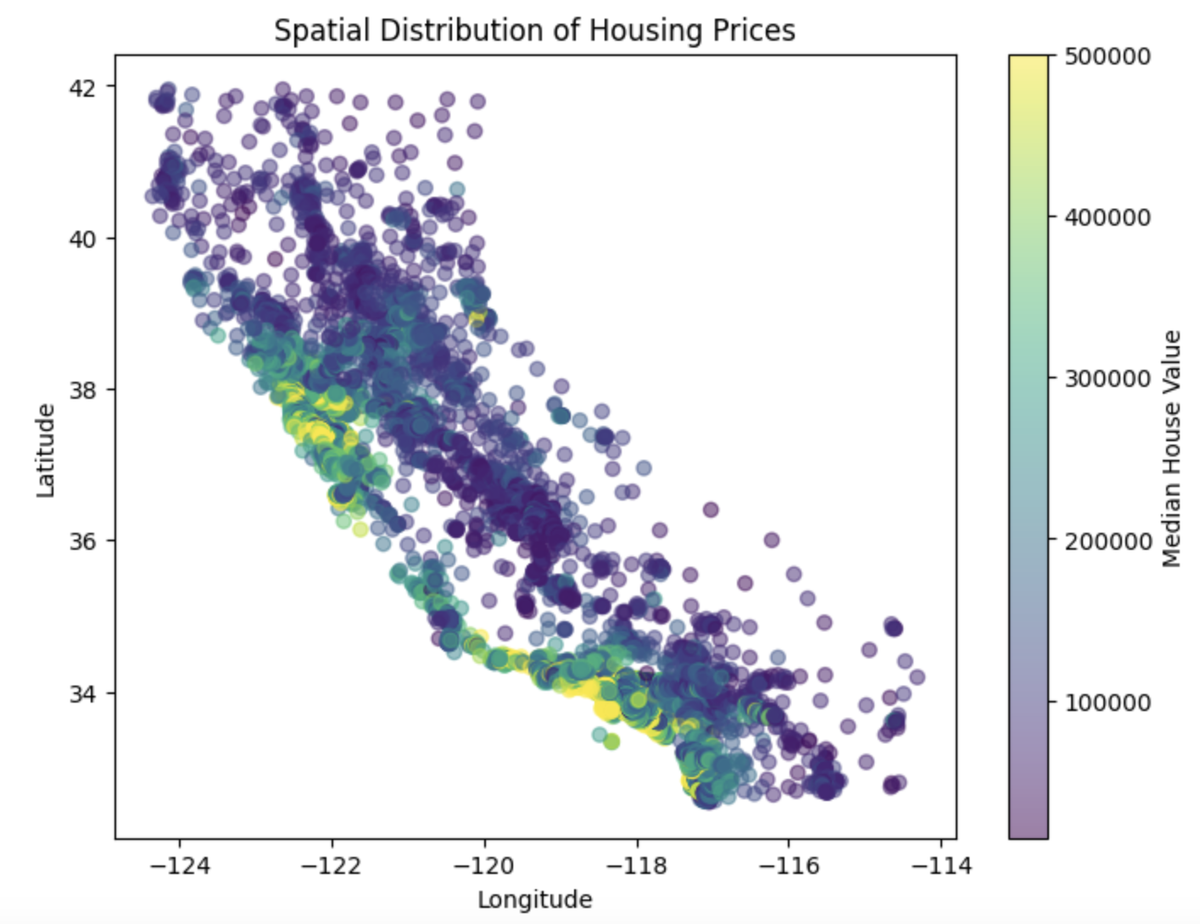
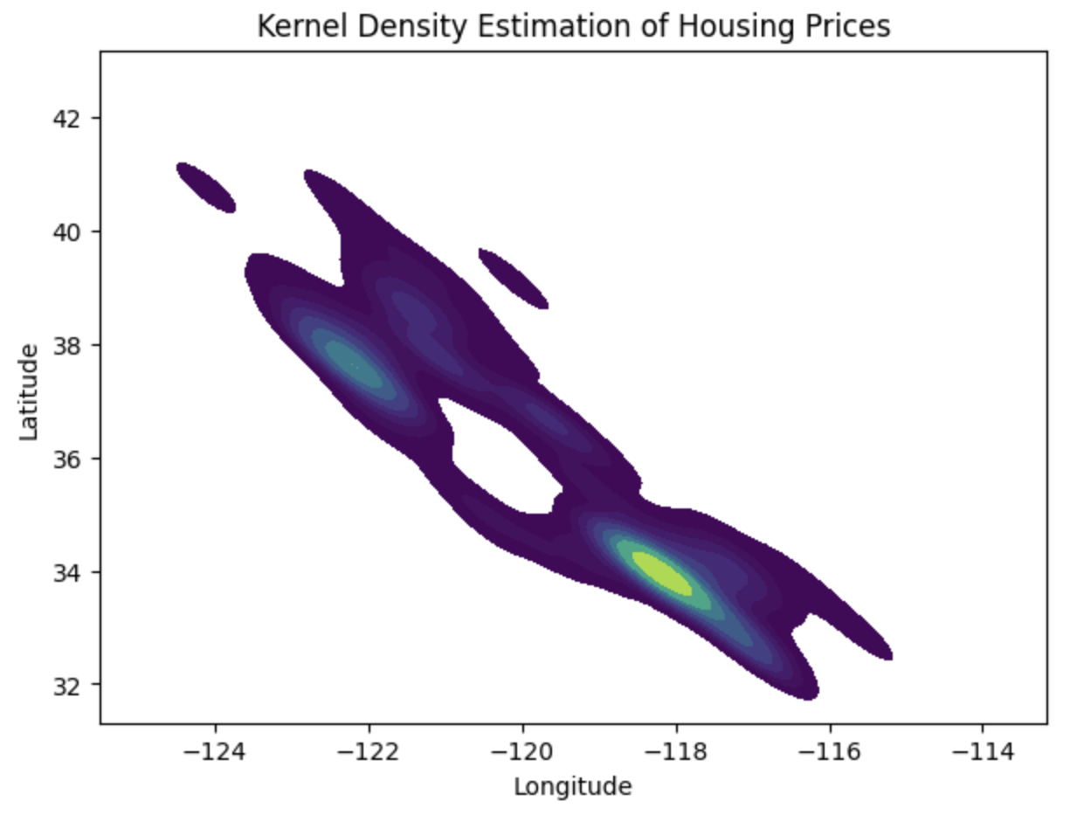
Investigating Housing Prices
Useful for interpreting housing values across regions
Most median house value is around 100000
Negative correlation
Housing prices are the highest of longitudes between -116 and -120, and latitude around 30-40
Notes:
The plots visualize how housing prices vary across different geographical locations

Slide 8
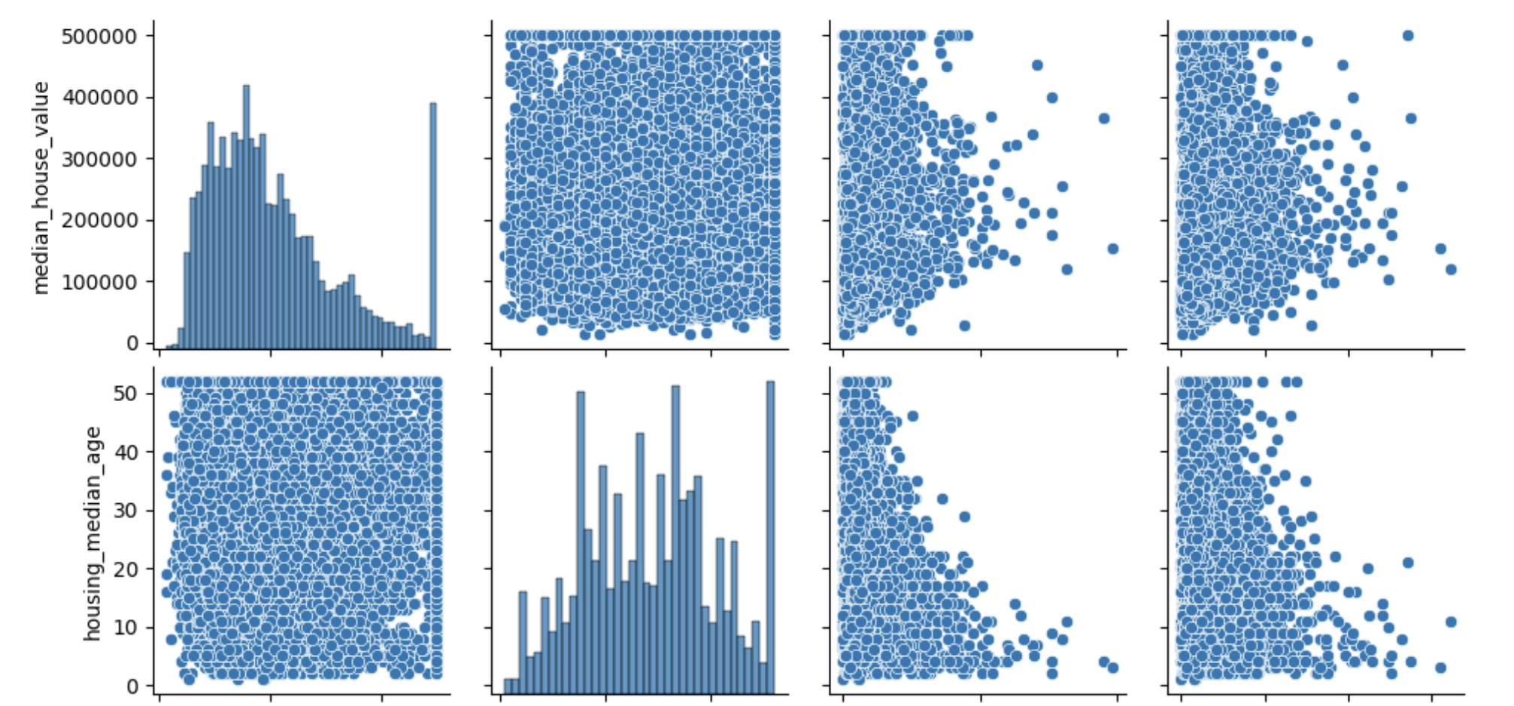
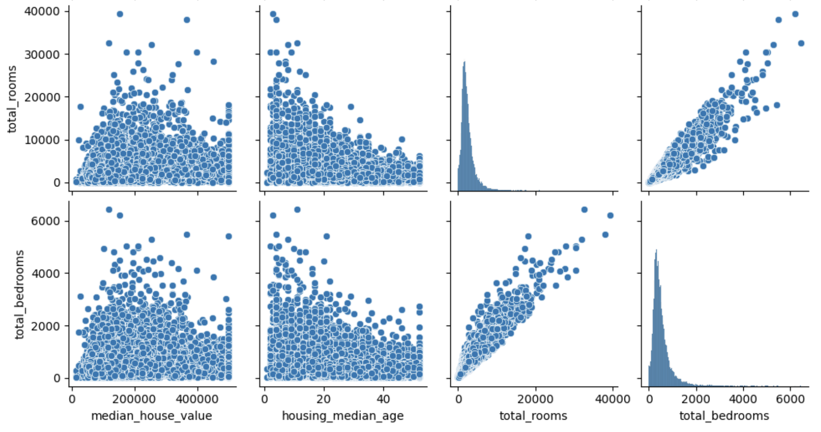
Investigating Housing Characteristics
Positive correlation: Points sloping upwards from left to right
Negative correlation: Points sloping downwards from left to right
No correlation: Points scattered randomly

Slide 9
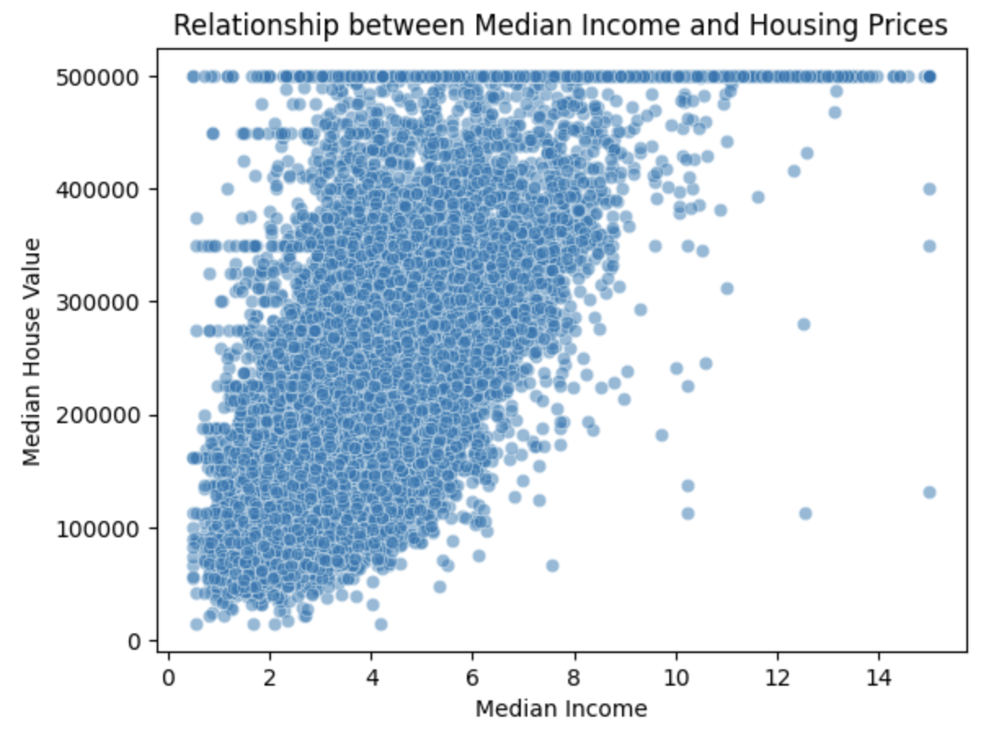
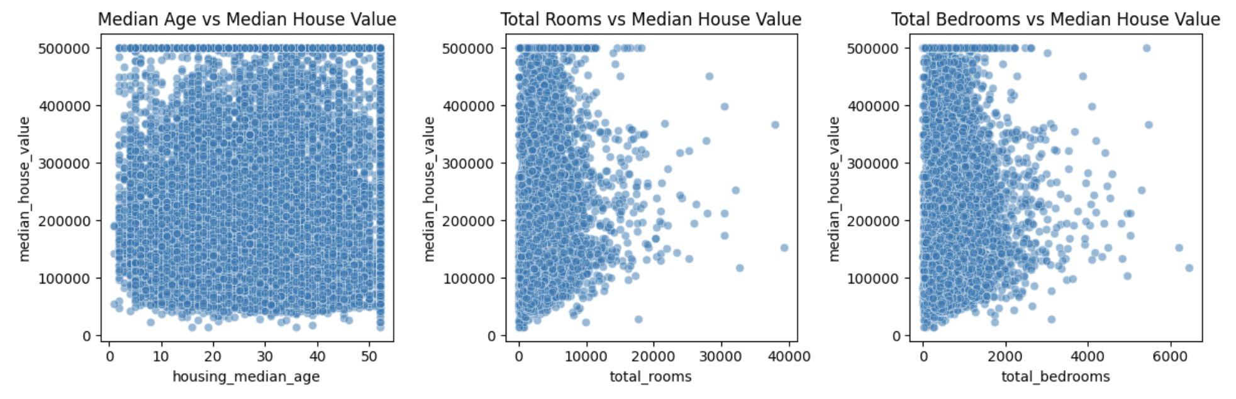
Investigate Correlation between Variables and Median House Value
Median Age: Not much correlation
Total rooms: Unknown or non-linear correlation
Total bedrooms: Unknown or non-linear
Median Income: Somewhat positive correlation

Slide 10
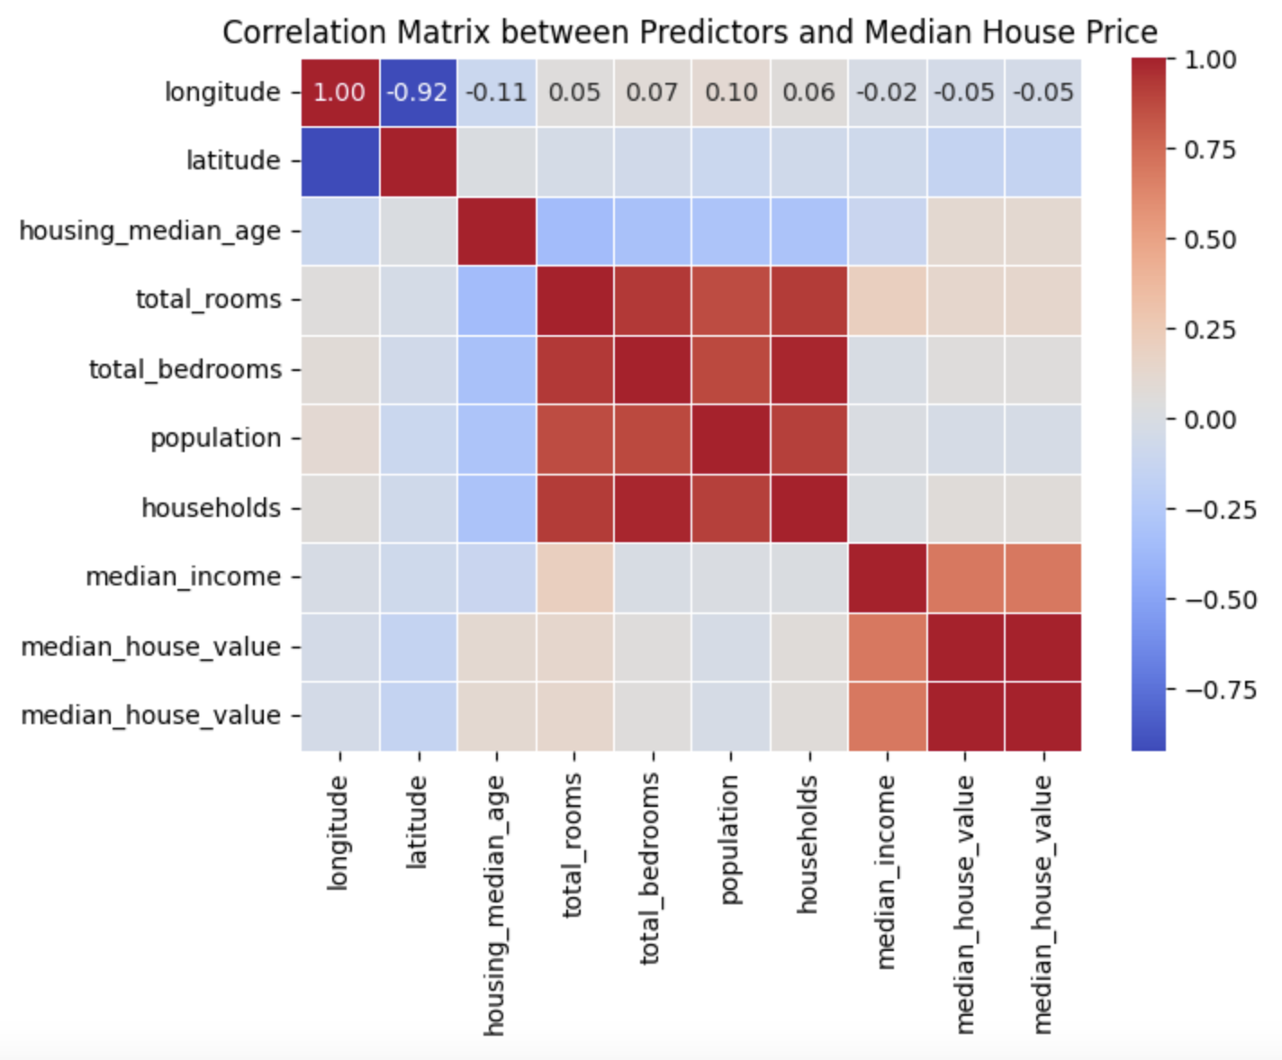
Find Correlation between Median House Price & Predictors
Darker red – higher positive correlation
Darker blue – higher negative correlation
Highest positive correlation with median house price – Median income

Slide 11
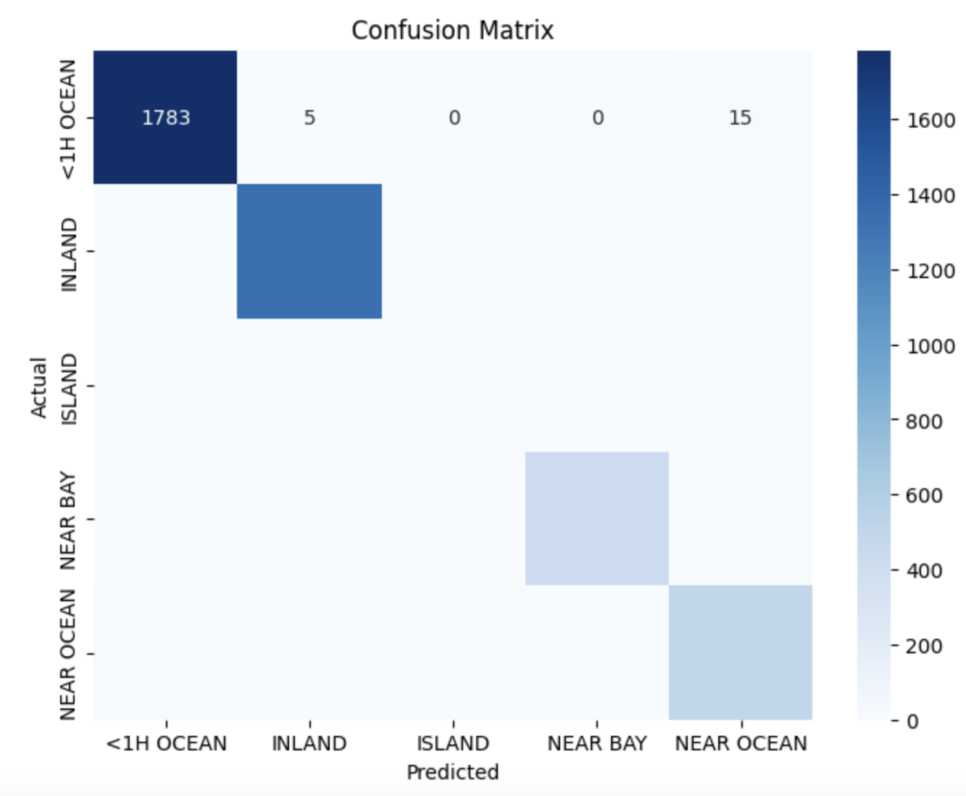
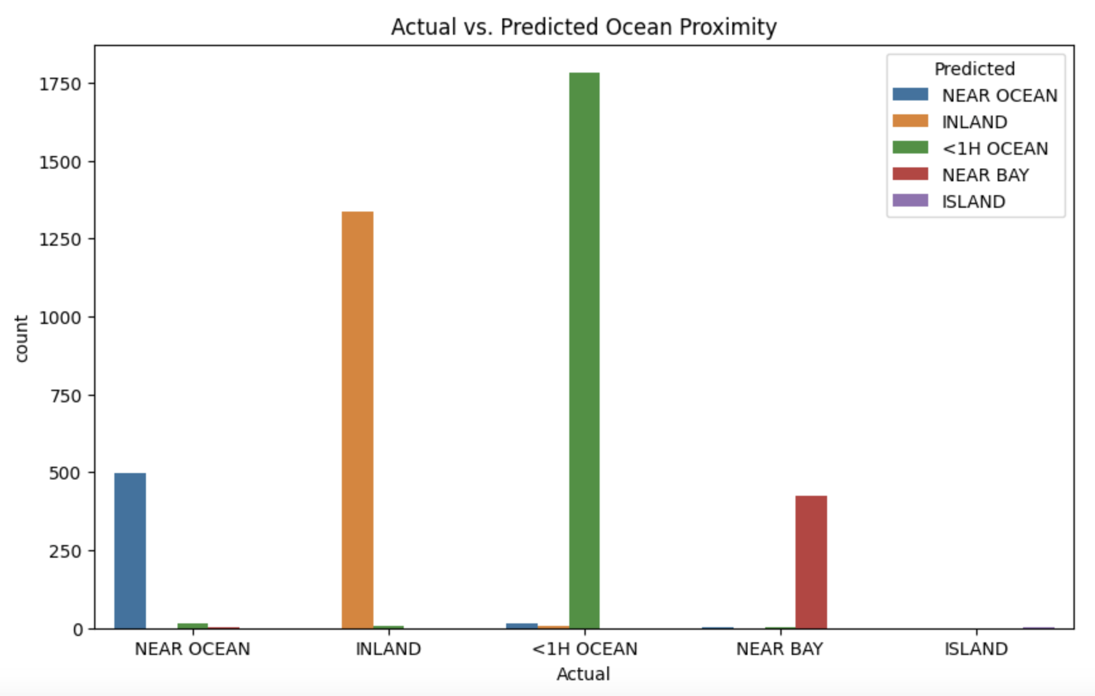
Model building: Random Forest Classifier
Accuracy: 99%
Target Variable: Ocean Proximity
Prediction: <1H Ocean (within 1 hour from the ocean)

Slide 12
Tools & Techniques
Language used: Python Jupyter Notebook
Libraries: pandas, matplotlib, seaborn, scikitlearn
Data Manipulation and Descriptive Statistics
Data Visualization
Classification Analysis for Predictions

Slide 13
Conclusions
House prices peak between longitudes -120 to -116 and latitudes 30 to 40
Median income and median house price are correlated
Most house sales were predicted to be within 1 hour from the ocean
Useful for real estate business for future planning, marketing, sales, etc.

Slide 14

THANK YOU!

